Slide 1
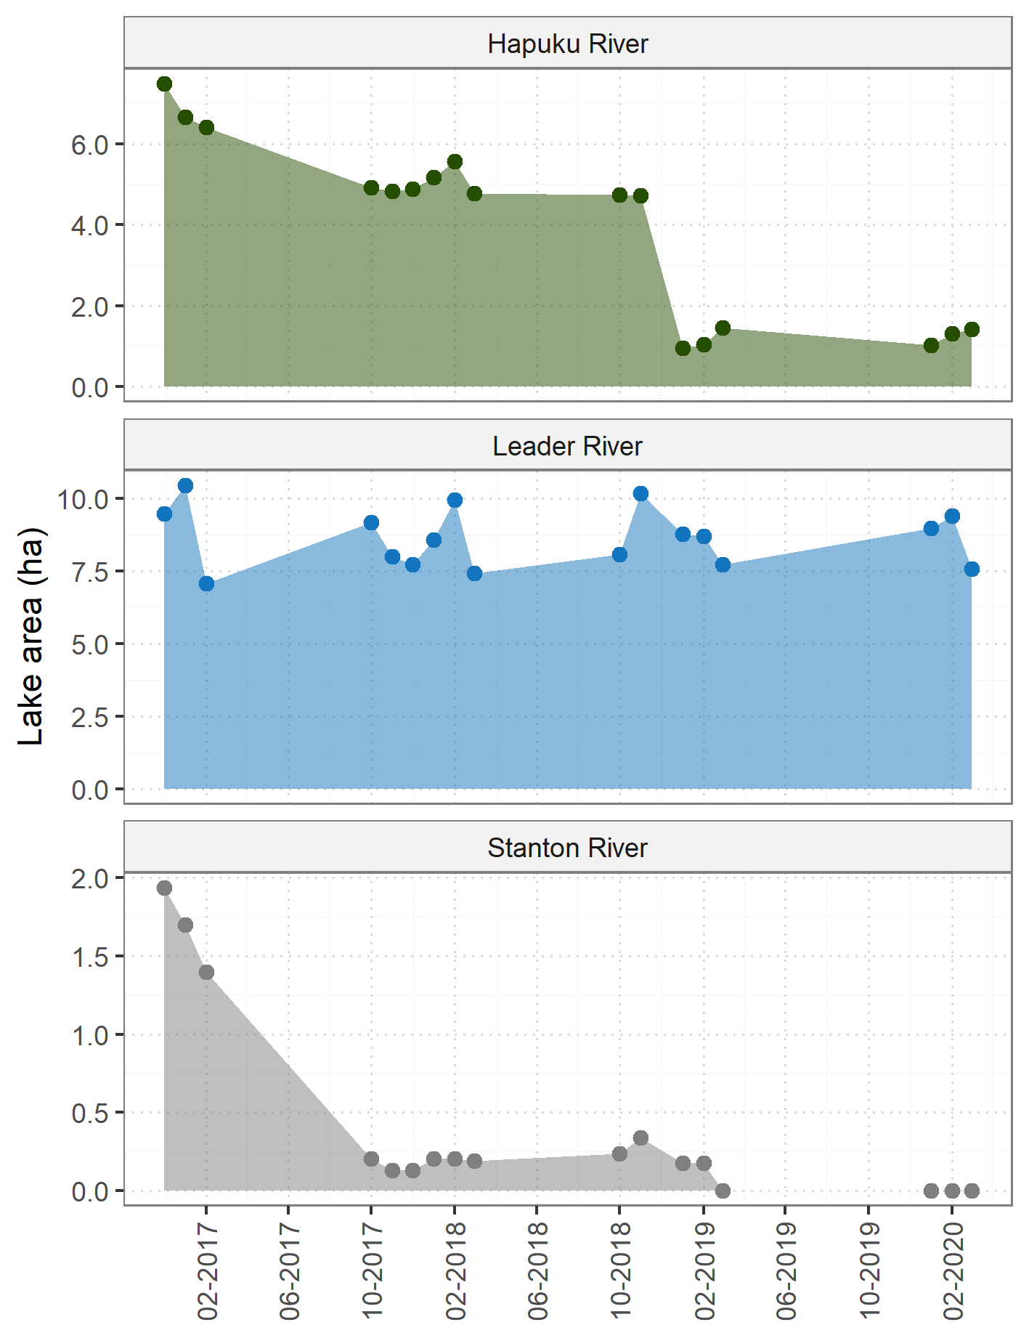
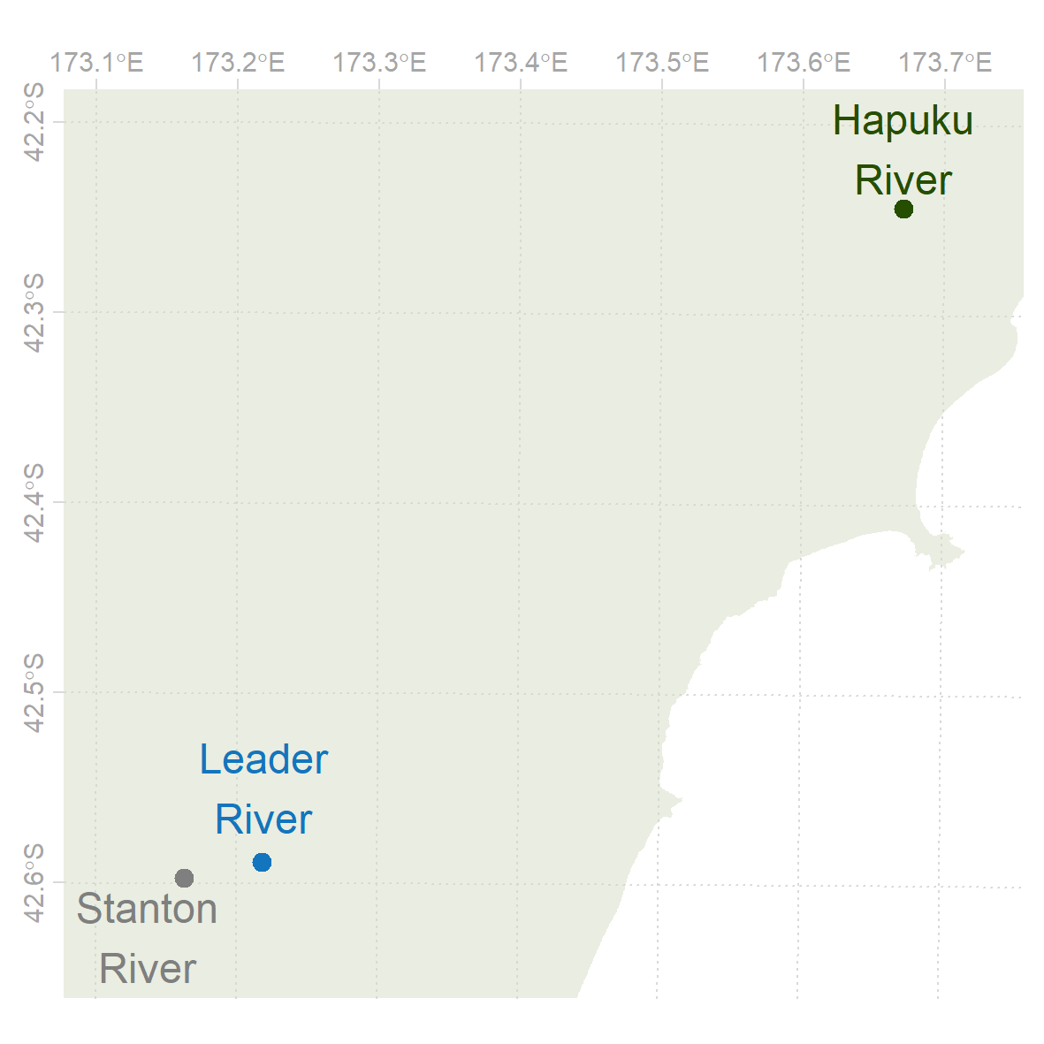
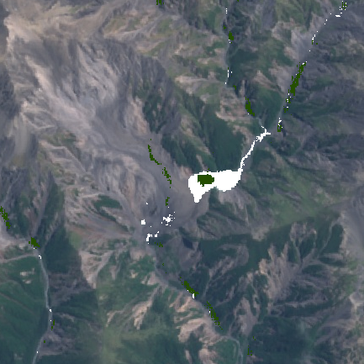
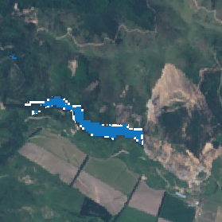
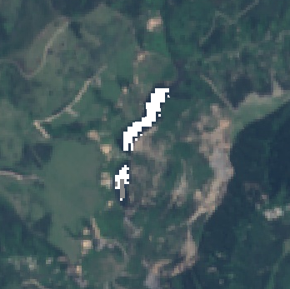
Session NH6.1
Live chat:
Thu, 07 May, 14:00–15:45
Mapping and monitoring of landslide-dammed lakes using Sentinel-2 time series A case study after the 2016 Kaikōura Earthquake in New Zealand

Slide 2
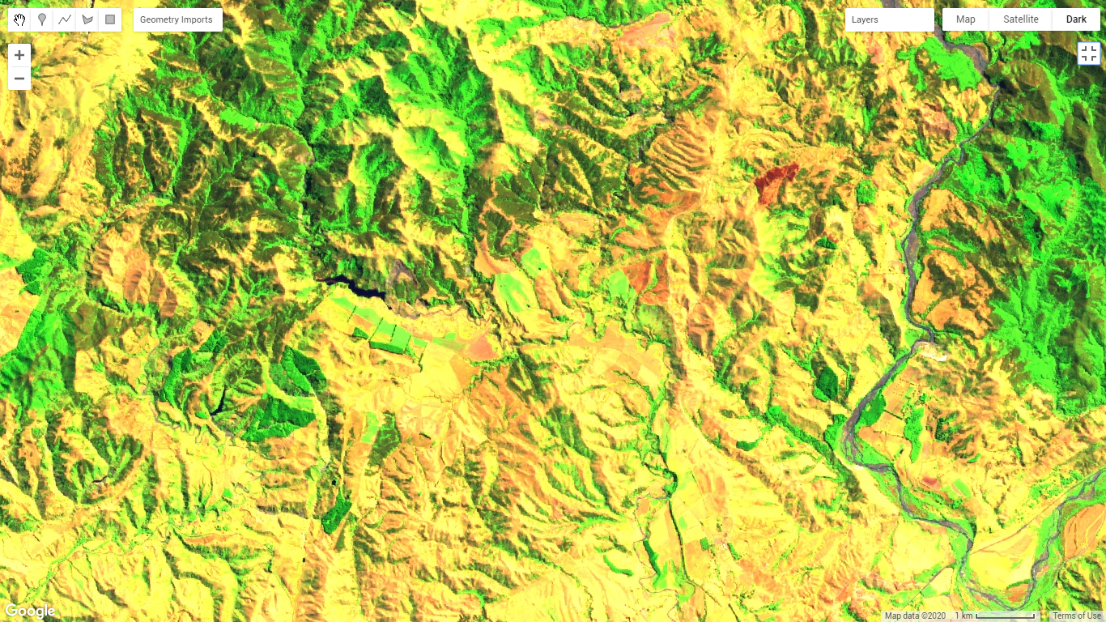

Mapping and monitoring of landslide-dammed lakes using Sentinel-2 time series A case study after the 2016 Kaikōura Earthquake in New Zealand
Lorena Abad¹
Daniel Hölbling¹
Raphael Spiekermann²
Zahra Dabiri¹
Günther Prasicek^{3,4}
Anne-Laure Argentin³
¹Department of Geoinformatics - Z_GIS, University of Salzburg, 5020 Salzburg, Austria
²Manaaki Whenua - Landcare Research, Palmerston North 4442, New Zealand
³Department of Geography and Geology, University of Salzburg, 5020 Salzburg, Austria
⁴Center for Interdisciplinary Mountain Research, University of Lausanne, 1967 Bramois, Switzerland
Session NH6.1 – Live chat: Thu, 07 May, 14:00–15:45

